Slide 1
Basics of PHP
By: Tamal Dey
Assistant Professor,
Dept. of CA
PESU

Slide 2
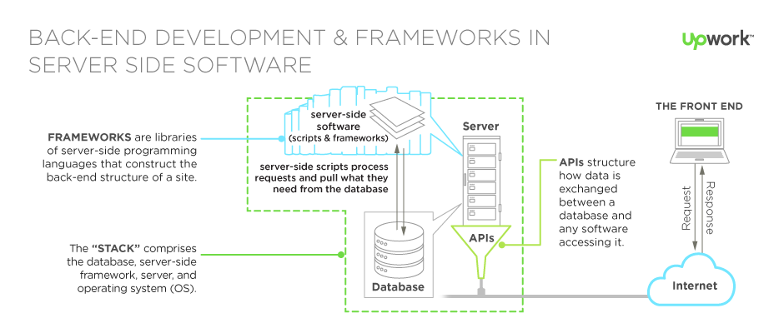
The back end comprises three parts: the server, your database, any APIs, and a back-end web application, software written via server-side languages.
Server-side scripts are used by back-end web developers to build the back-end software of a website

Slide 3
Index
Introduction
Installing PHP
Basic Syntax
PHP Variables
Echo/Print
Data Types
Strings
Constants
Expressions
Operators
Control Structures & Loops
Enumerated and Associative Arrays
Array Iteration
Sorting
Multi- Dimensional Arrays
Functions, Arguments &References
Return Values & Variable Scope
Pass by Value & Pass by references

Slide 4
Introduction
PHP is a server scripting language, and a powerful tool for making dynamic and interactive Web pages.
PHP is a widely-used, free, and efficient alternative to competitors such as Microsoft's ASP.
PHP is a programming language that can do all sorts of things:
evaluate form data sent from a browser
build custom web content to serve the browser
talk to a database
even send and receive cookies

Slide 5
What is PHP?
PHP is a script language and interpreter that is freely available and used primarily on Linux Web servers. PHP, originally derived from Personal Home Page Tools, now stands for PHP: Hypertext Preprocessor, which is describes as a "recursive acronym.”
Developed by Rasmus Lerdorf (a member of Apache Group) in 1994 to allow him to track visitors to his Web site
PHP is an open-source product
PHP is a server side scripting language whose scripts are embedded in XHTML documents, naturally used for form handling , file processing and database access.
PHP support electronic mail protocols POP3, IMAP etc. ,Distributed object architecture, COM (Component Object Model) and CORBA (Common Object Request Broker Architecture).

Slide 6

Overview of PHP
Server determines that document includes PHP script by the extensions
.php, .php3, phtml
PHP is an alternative to CGI, ASP.NET, JSP etc.
When a PHP document is requested of a server, the server will send the document first to a PHP processor. The result of the processing is the response to the request
PHP processor has two modes of operation:
1.Copy mode (HTML) : PHP script in the input file is copied to the output file and produces an HTML or XHTML document file.
2.Interpret mode (PHP) : PHP script in the input file is interpreted and sends output of the script to the output file.

Slide 7
Overview of PHP
The client never sees PHP code, only the output produced by the code
PHP has typical scripting language characteristics
Dynamic content
Associative arrays
Pattern matching
Extensive libraries
PHP syntax is similar to that of JavaScript and Perl
PHP is purely interpreted
Visit http://php.net
With PHP you are not limited to output HTML. You can output images, PDF files, and even Flash movies. You can also output any text, such as XHTML and XML.

Slide 8
What is a PHP File?
PHP files can contain text, HTML, CSS, JavaScript, and PHP code
PHP code are executed on the server, and the result is returned to the browser as plain HTML. PHP files have extension ".php"
What Can PHP Do?
PHP can generate dynamic page content
PHP can create, open, read, write, delete, and close files on the server
PHP can collect form data
PHP can send and receive cookies
PHP can add, delete, modify data in your database
PHP can be used to control user-access
PHP can encrypt data
Notes:
An HTTP cookie (also called web cookie, Internet cookie, browser cookie or simply cookie) is a small piece of data sent from a website and stored in the user's web browser while the user is browsing. Cookies were designed to be a reliable mechanism for websites to remember stateful information (such as items added in the shopping cart in an online store) or to record the user's browsing activity (including clicking particular buttons, logging in, or recording which pages were visited in the past). They can also be used to remember arbitrary pieces of information that the user previously entered into form fields such as names, addresses, passwords, and credit card numbers.

Slide 9
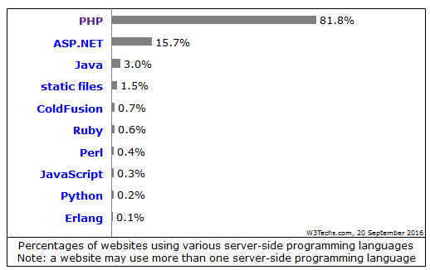
Why to use PHP?
PHP runs on various platforms (Windows, Linux, Unix, Mac OS X, etc.)
PHP is compatible with almost all servers used today (Apache, IIS, etc.)
PHP supports a wide range of databases

Slide 10
LAMP
Open Terminal (Linux,Apache, Mysql, Php, Python,Perl
sudo apt-get install lamp-server^
Display errors of program
sudo gedit /etc/php/7.0/apache2/php.ini
Now scroll down through the file until you find the following line.
display_errors = Off On (Line no 334)
Once you have made the swap save the file and then exit the editor.
Restart Apache
sudo service apache2 restart(stop/start)

Slide 11
Editors
ls –l /var/www/html/
sudo chmod 777 -R /var/www/html/
Create a folder (php)
http://localhost/php/program-name.html
Sublime
Brackets
Atom
Gedit
https://www.w3schools.com/php/php_intro.asp
https://www.tutorialrepublic.com/php-examples.php
https://www.javatpoint.com/php-tutorial
https://www.tutorialspoint.com/php/

Slide 12
General Syntactic Characteristics
PHP code can be specified in an XHTML
Internally: <?php
...
?>
Externally: include ("myScript.inc")
The file can have both PHP and HTML
Thus, code in an include file must be in <?php and ?> tags
Every variable name in PHP begin with a $
Variable names are case sensitive
However keywords and function names are not case sensitive

Slide 13
PHP Syntax
Comments - three different kinds (Java and Perl)
// ...
# ...
/* ... */
PHP statements are terminated with semicolons
Curly braces {} are used to create compound statements
Compound statements cannot be blocks
Variables: There are no type declarations

Slide 14
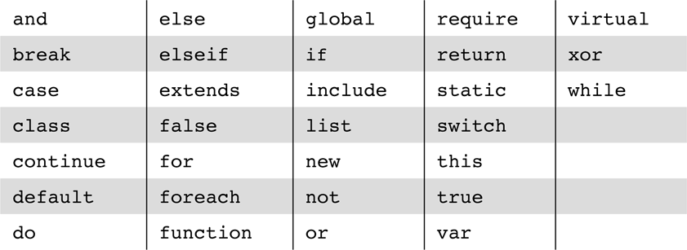
The reserved words of PHP

Slide 15
PHP is a Loosely Typed Language
PHP automatically converts the variable to the correct data type, depending on its value.
PHP Variables Scope
variables can be declared anywhere in the script.
scope of a variable is the part of the script where the variable can be referenced/used.
PHP has three different variable scopes:
local
global
static

Slide 16
Global and Local Scope
A variable declared outside a function has a GLOBAL SCOPE and can only be accessed outside a function
A variable declared within a function has a LOCAL SCOPE and can only be accessed within that function:
local variables with the same name in different functions, because local variables are only recognized by the function in which they are declared.
PHP The global Keyword
The global keyword is used to access a global variable from within a function.
use the global keyword before the variables (inside the function):
local variables in an array called $GLOBALS[index]. The index holds the name of the variable

Slide 17
The static Keyword
Normally, when a function is completed/executed, all of its variables are deleted. However, sometimes we want a local variable NOT to be deleted. We need it for a further job.
To do this, use the static keyword when you first declare the variable:
Each time the function is called, that variable will still have the information it contained from the last time the function was called.

Slide 18
Primitives, Operations, Expressions
PHP has four scalar types:
Boolean
Double
String
Integer
Two compound types: array, object
Two special types: resource and NULL
http://www.e-reading.ws/htmbook.php/orelly/webprog/php/ch02_02.htm
http://www.w3schoolas.com/php%20data%20types.php
You can get a list of the predefined variables by calling phpinfo() in a script

Slide 19
Variables
Variables are not declared except in order to specify scope or lifetime
A variable that has not been assigned a value is unbound and has the value NULL
The unset function sets a variable to NULL
unset($list[2]) see unset.php
The IsSet function is used to determine whether a variable is NULL (E.g.: Session.php)

Slide 20
Integer Type
PHP distinguishes between integer and floating point numeric types
Integer is equivalent to long in C, that is, usually 32 bits
<?php $int_var = 1234; # decimal number $_var = -123; # a negative number $_var = 0123; # octal number (equivalent to 83 decimal) $_var = 0x1A; # hexadecimal number (equivalent to 26 decimal) ?>

Slide 21
Double Type
Literal double type numeric values include a period and/or the exponent sign: either e or E
Double type values are stored internally as double precision floating point values
There need not be any digits before or after the decimal point
.345 and 345. are legal double literals
<?php $flot_var = 1.234; $flot_var = 1.3e4; $flot_var = 8E-10; ?>

Slide 22
String Type
Characters in PHP are one byte
String literals are enclosed in single or double quotes
Double quoted strings have escape sequences interpreted and variables interpolated
Single quoted strings have neither escape sequence interpretation nor variable interpolation (insertion)
A literal $ sign in a double quoted string must be escaped with a backslash \
Double-quoted strings can cover multiple lines, the included end of line characters are part of the string value
Double quote
“This is \n a string”
O/p:
This is a string
Single quote ‘This is a string’.

Slide 23
Boolean Type
The boolean type has two values :
TRUE and FALSE
Other type values are coerced as needed by context, for example, in control expressions
The integer value 0, the empty string and the literal string “0” all count as false
NULL counts as false
The double value 0.0 counts as false. Beware, however, that double calculations rarely result in the exact value 0.0
<?php $bool_var = True; // assign the value TRUE to $bool_var ?>

Slide 24
Two compound types:
1). Array Data Types
An array is a collection of elements of heterogeneous type.
There are three different kind of arrays:
1). Numeric Array 2). Associative Array 3). Multidimensional Array
Numeric Array
A numeric array stores each array element with a numeric index (ID Key).
There are different ways to create a numeric array. (the index starts at 0):
$employee_array=array("Raj","Sanjay","Mahesh","Ram");

Slide 25
this example we assign the index manually:
$employee_array[0] = "Raj"; $employee_array[1] = "Sanjay"; $employee_array[2] = "Mahesh"; $employee_array[3] = "Ram";

Slide 26
2). Object
PHP supports object-oriented programming (OOP). OOP promotes clean modular design, simplifies debugging and maintenance, and assists with code reuse.
Classes are the unit of object-oriented design.
A class is a definition of a structure that contains properties (variables) and methods (functions). Classes are defined with the class keyword:
class Person {
$newname = '‘Chetan'';
function name ($newname = NULL) {
if (! is_null($newname)) {
$this->name = $newname;
} return $this->name;
}}

Slide 27
PHP NULL Value
Null is a special data type which can have only one value: NULL.
A variable of data type NULL is a variable that has no value assigned to it.
Tip: If a variable is created without a value, it is automatically assigned a value of NULL.
Variables can also be emptied by setting the value to NULL
<?php $x = "Hello world!"; $x = null; var_dump($x); ?>

Slide 28
Resource
The special resource type is not an actual data type.
It is the storing of a reference to functions and resources external to PHP.
A common example of using the resource data type is a database call.

Slide 29
Arithmetic Operators and Expressions
PHP supports the usual operators supported by the C/C++/Java family
Integer divided by integer results in integer if there is no remainder but results in double if there is a remainder
12/6 is 2
12/5 is 2.4
A variety of numeric functions is available: floor, ceil, round, srand, abs, min, max

Slide 30
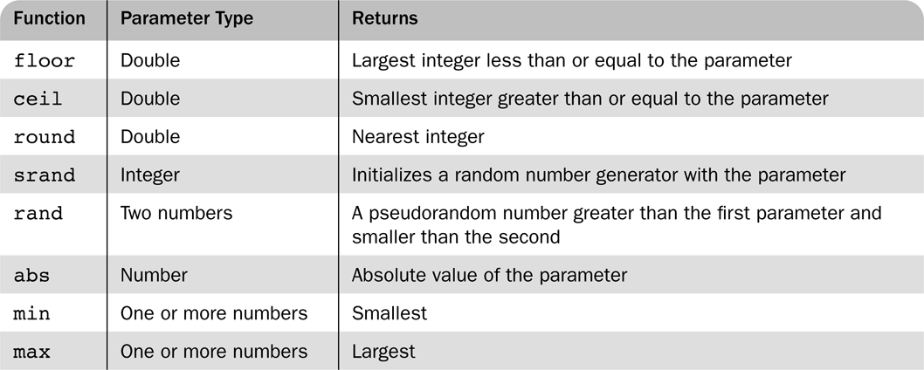
Some useful predefined functions
floor.php, rand-srand.php and abs.php

Slide 31
String Operations
String catenation is indicated with a period
Characters are accessed in a string with a subscript enclosed in curly braces
$str value is apple, so $str{3} is “l”.
Many useful string functions are provided
strlen gives the length of a string
strcmp compares two strings as strings
Chop removes whitespace from the end of a string
Other String functions
strpos, substr, as in C

Slide 32
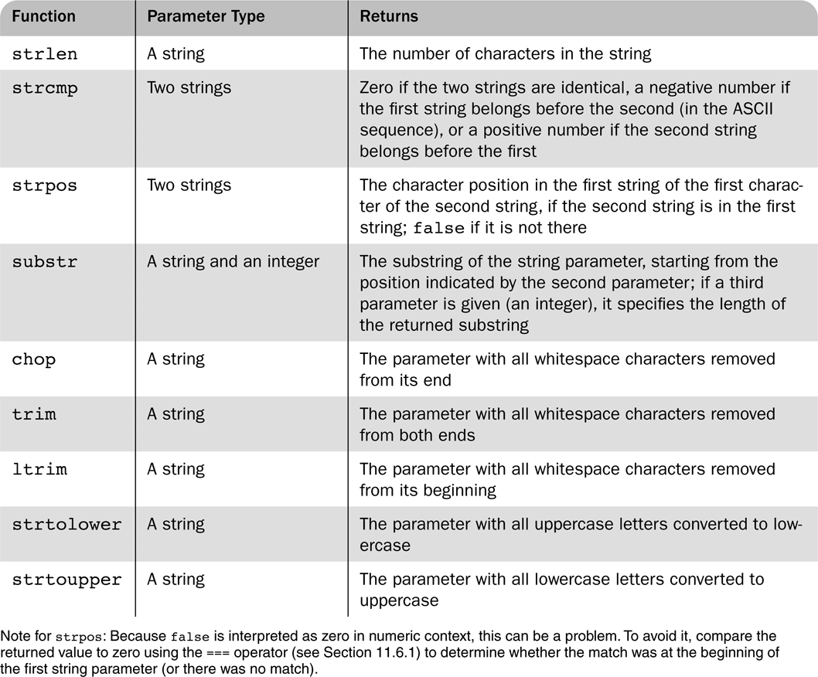
Some commonly used string functions

Slide 33
Scalar Type Conversions
Implicit type conversions (coercions) as demanded by the context in which an expression appears (type.php)
A string is converted to an integer if a numeric value is required
A string is converted to a double if a numeric value is required and the string is a valid double literal
Explicit type conversions can be forced in the following 3 ways $sum=4.777
(int)$sum
intval($sum)
settype($sum, “integer”)
Type can be determined with the gettype function and with the is_int function and similar functions
Other types are is_double, is_long, is_bool, is_real, is_string etc.

Slide 34
Output
The print function is used to send data to output
print takes string parameters
The Sprintfunction is also available
The first argument to printf is a string with interspersed (scatter) format codes
A format code begins with % followed by a field width and a type specifier
Common types specifiers are s for string, d for integer and f for double
Field width is a single integer to specify the number of characters (minimum) used to display the value or two integers separated by a period to indicate field width and decimal places for double values

Slide 35
Output
Specifier Input type Output Format b Integer Binary number C Integer Single character D Integer Signed decimal number U Integer Unsigned decimal number F Floating-point number Floating-point number O Integer Octal number S String String x Integer Hexadecimal number with lowercase letters X Integer Hexadecimal number with uppercase letters

Slide 36
printf(“x = %5d is %s\n”, $x, $size);
Displays $x as an integer and $size as a string
Print “Apples are Red<br/> Cucumber are not <br/>”;
Print(47);
print “The Result” $result <br/>;
Syntax:
Printf (literal_string, param1, param2,….)
%10s, %6d, %5.2f
echo can be used for message printing
The example today.php uses the date function to dynamically generate a page with the current date

Slide 37
Echo, Print, PrintF Difference
printf — Output a formatted string ,print returns a value. It always returns 1.
echo - Output one or more strings
The print function is slightly more dynamic than the echo function by returning a value, and the echo function is slightly (very slightly) faster.
The printf function inserts dynamic variables wherever you want with special delimiters, such as %s, or %d.
For example,
printf('There is a difference between %s and %s', 'good', 'evil')
would return 'There is a difference between good and evil'.

Slide 38
Constant
Constants are like variables except that once they are defined they cannot be changed or undefined.
A constant is an identifier (name) for a simple value. The value cannot be changed during the script.
A valid constant name starts with a letter or underscore (no $ sign before the constant name).
Note: Unlike variables, constants are automatically global across the entire script.
To create a constant, use the define() function.
define(name, value, case-insensitive)

Slide 39
Assignment Operators
The assignment operators used in C/C++/Java are supported in PHP
Some compound assignment operators are += and /=

Slide 40
Relational Operators
PHP has the usual comparison operators:
>, <, <=, >=, == and !=
PHP also has the identity operator ===
Results TRUE if both operands are same type and has same value. Its opposite is !==

Slide 41
Boolean Operators
PHP supports &&, || and ! as in C/C++/Java
The lower precedence version and and or are provided
The xor operator is also provided

Slide 42
Selection Statements
PHP’s if statement is similar to C
The only difference is the elseif
The switch statement is provided with syntax and semantics similar to C/C++/Java
The case expressions are coerced before comparing with the control expression
break is necessary to prevent execution from flowing from one case to the next

Slide 43
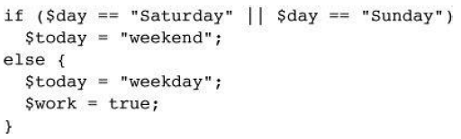
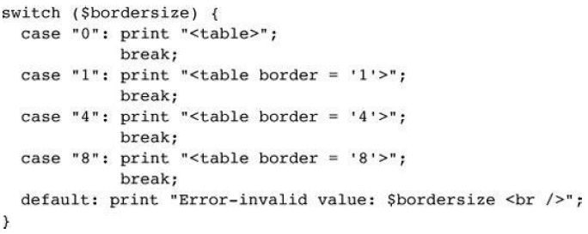
If Statement
Switch Statement

Slide 44
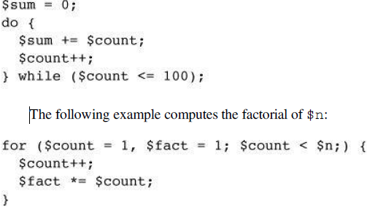
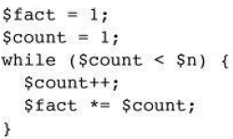
Loop Statements
PHP provides the while and for and do-while as in JavaScript
The for loop is illustrated in the example powers.php
This example also illustrates a number of mathematical functions available in PHP.
Following example computes sum of positive number up to 100
Factorial of $n

Slide 45
multiply.php
<?php
$a = 7;
$b = 7;
if ($a == $b) {
$a = 3 * $a;
?>
<br /> At this point, $a and $b are equal <br />
So, we change $a to three times $a=
<?php
print $a;}
?>

Slide 46
Array
Arrays in PHP combine the characteristics of regular arrays and hashes
An array can have elements indexed numerically. These are maintained in order
An array, even the same array, can have elements indexed by string. These are not maintained in any particular order
The elements of an array are, conceptually, key/value pairs
Arrays can have mixed kinds of elements
$list[0] = 10;
$list[1] = “Say hello to PHP”;
$list = array(1, 3, 5, 7, 9);
$list = array("make" => "Cessna",
"model" => "C210",
"year" => 1960,
3 => "sold");

Slide 47
Array Creation
An array is a special variable, which can hold more than one value at a time
Assigning a value to an element of an array
Using the array function
Create a numerically indexed array
array(23, ‘xiv’, “bob”, 777);
Create an array with string indexes
$list=array(“x” => “42”, “y” => “college”)
$list = array();
$ages = array(“Joe”=>23, “Marry”=>29);
$list[0]= 17;
$list[1]=“Today is Bob’s Birthday”;
$list[]=47;

Slide 48
Accessing Array Elements
Array elements are set / accessed by using a subscript in square brackets
$ages[‘Marry’] = 29;
An array can be assigned to a list of variables
Multiple array element can be assigned to scalar variable
$trees= array (“oak”, “pine”, “binary”);
list($hardwood, $softwood, $data_structure) = $trees;
print “$hardwood” //result oak
print “$softwood” //result pine
print “$data_structure” //result binary

Slide 49
Functions for Dealing with Arrays
The unset function can be used to remove an array or an element of an array
$list = array (2 , 4 , 6 , 8); unset($list[2]);
The array_keys function returns a list of the keys of an array
The array_values returns a list of values in an array
$weather = array(“Mon=> 34 ,“Tue”=>30,“Wed”=> 28,“Thu => 25, Fri”=> 23);
$days = array_keys($weather);
$temp = array_values($weather);

Slide 50
The array_key_exists function returns true if a given key is actually present in a given array
if (array_key_exists(“Tue”, $weather)) {
$weather = $weather [ “Tue”];
print “The weather of Tue was $weather”;
is_array determines if its argument is an array
in_array determines element exist in an array and takes two paramenters
implode converts an array of strings to a single string, separating the parts with a specified string
$words=array(“Today”, “is”, “a”, “great”, “day”);
$str= implode(“ ”, $words);
explode converts a string into a list of strings by separating the string at specified characters

Slide 51
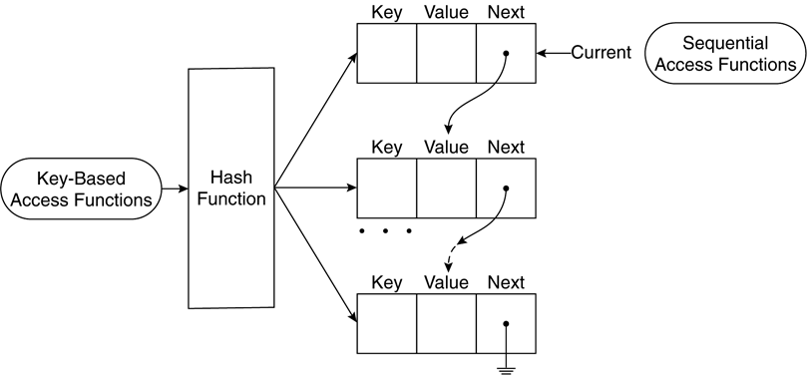
Logical internal structure of arrays

Slide 52
Sequential Access to Array Elements
PHP maintains a marker in each array, called the current pointer
Several functions in PHP manipulate the current pointer
The pointer starts at the first element when the array is created
$cities= array(“Chicago”, “Atlantis”, “Tokyo”);
$city=current($cities);
printf “ the first city is $city”;
The next function moves the pointer to the next element and returns the value there
$city=current($cities);
print “$city”;
while ($city = next($cities))
printf(“$city <br/>);

Slide 53
Sequential Access of Array Element
The each function move the pointer to the next element and returns the key/value pair at the previous position
$salaries= array(“Mike” => 42500, “Jerry”=> 51520);
While ($employee =each($salaries)) {
$name = $employee [“key”];
$salary = $employee [“value”];
print(“The salary of $name is $salary);
Functions return false if no more elements are available
prev moves the pointer back towards the beginning of the array
reset moves the pointer to the beginning of the array

Slide 54
Arrays as Stacks
PHP provides the array_push function that appends its arguments to a given array
The function array_pop removes the last element of a given array and returns it

Slide 55
Iterating Through an Array
The foreach statement has two forms for iterating through an array
foreach (array as scalar_variable) loop body
assigns each value in the array to the caller_variable in turn
foreach (array as key => value) loop body
assigns each key to key and the associated value to value in turn
In this example, each day and temperature is printed
$lows = array("Mon" => 23, "Tue" => 18, "Wed" => 27);
foreach ($lows as $day => $temp)
print("The low temperature on $day was $temp <br />");

Slide 56
Sorting Arrays
The sort function sorts the values in an array and makes a numerically subscripted array from the sorted list.
Sort the values of an array, leaving the keys in their present order - intended for traditional arrays
e.g., sort($list);
The function asort sorts based on values in an array but keeps the original key/value association - intended for hashes

Slide 57
Ksort:The function ksort is similar to asort but sorts by keys. To sort the elements of an array by the keys, maintaining the key/value relationships
e.g., $list("Fred" => 17, "Mary" => 21,
"Bob" => 49, "Jill" => 28);
ksort($list);
$list is now ("Bob" => 49, "Fred" => 17, "Jill" => 28, "Mary" => 21)
The functions rsort, arsort and krsort are similar but sort in reverse order
The example sorting.php illustrates the various sort functions

Slide 58
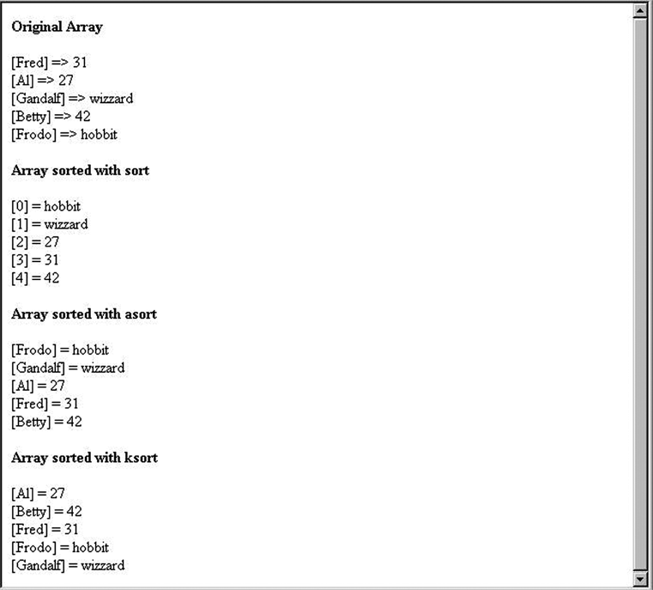
The output of sorting.php

Slide 59
Multidimensional Array
A multidimensional array is an array containing one or more arrays.
PHP understands multidimensional arrays that are two, three, four, five, or more levels deep
The dimension of an array indicates the number of indices you need to select an element.
For a two-dimensional array you need two indices to select an element
For a three-dimensional array you need three indices to select an element
Arrays that are a single list of key/value pairs.
However, sometimes you want to store values with more than one key.

Slide 60
Now the two-dimensional $cars array contains four arrays, and it has two indices: row and column.
To get access to the elements of the $cars array we must point to the two indices (row and column):
$cars = array ( array("Volvo",22,18), array("BMW",15,13), array("Saab",5,2), array("Land Rover",17,15) );

Slide 61
General Characteristics of Functions
The parameters are optional, but not the parentheses
Function names are not case sensitive
A return statement causes the function to immediately terminate and return a value, if any, provided in the return
A function that reaches the end of the body without executing a return, returns no value

Slide 62
Function
Function syntax
function name([parameters]) {
...
}
function addOne(&$param) {
$param++;
}
$it = 16;
addOne($it); // $it is now 17

Slide 63
Parameters
A formal parameter, specified in a function declaration, is simply a variable name
If more actual parameters are supplied in a call than there are formal parameters, the extra values are ignored
If more formal parameters are specified than there are actual parameters in a call then the extra formal parameters receive no value
PHP defaults to pass by value
Putting an ampersand in front of a formal parameter specifies that pass-by-reference
An ampersand can also be appended to the actual parameter (which must be a variable name)

Slide 64
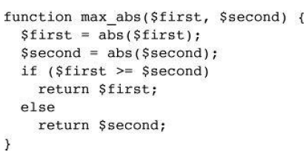
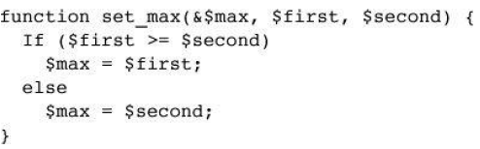
Actual parameter remain unchanged- Pass By Value
First actual parameter in the caller set to larger than second and third parameter – Pass be reference

Slide 65
The Scope of Variables
A variable defined in a function is, by default, local to the function
A global variable of the same name is not visible in the function
Declaring a variable in a function with the global declaration means that the functions uses the global variable of that name

Slide 66
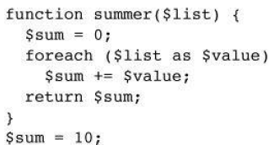
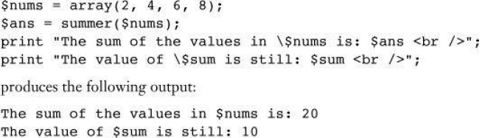
Local Variable

Slide 67
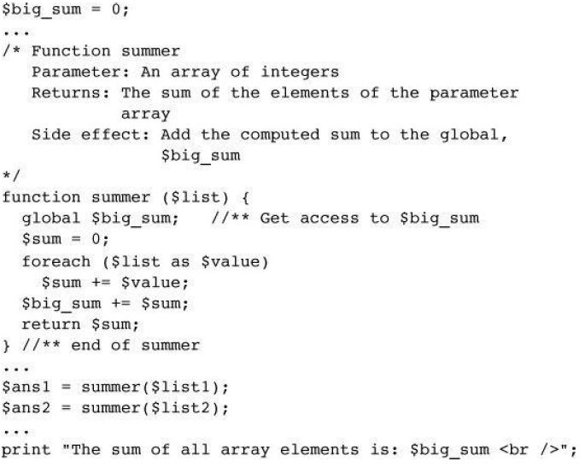
Global Variable

Slide 68
Lifetime of Variables
The usual lifetime of a local variable is from the time the function begins to execute to the time the function returns
Declaring a variable with the static keyword means that the lifetime is from the first use of the variable to the end of the execution of the entire script
In this way a function can retain some ‘history’

Slide 69
ALL THE BEST

